Slide 1
Introduction to the F-900

Slide 2
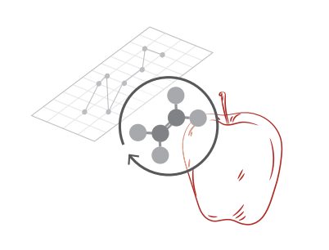
F-900 Features
High ethylene (C2H4) sensitivity
Compact and portable
Real-time, continuous monitoring
Internal data logging and storage
Transflective display for viewing in sunlight
Rechargeable Li-ion battery

Slide 3
About the F-900
Ethylene production is known to increase in response to plant stress and during fruit ripening and maturity
The F-900 provides a tool to aid in the development of ethylene management applications for researchers, growers, producers, and consumers
The ethylene sensors inside are unit are electrochemical sensors
Sample gas travels across the surface of the electrode and diffuses into the electrochemical cell where ethylene is oxidized

Slide 4
F-900 Theory of Operation
Ethylene diffuses into the electrochemical cell
The current created by the oxidation of ethylene is measured and converted to parts per million (ppm) of ethylene
Ethylene is oxidized by the presence of a strong oxidizing agent

Slide 5
F-900 Theory of Operation
Few sensors are selective to just one molecule, the ethylene sensors inside the F-900 are sensitive to other hydrocarbons in the sample gas being analyzed
It should be understood that these interferences are not necessarily linear and may also exhibit time dependent characteristics
In the presence of cross-sensitive gases the ethylene readings can become falsely high
The F-900 utilizes a function called “PolarCept” to absorb some of these competing gases and provide more accurate ethylene measurements

Slide 6
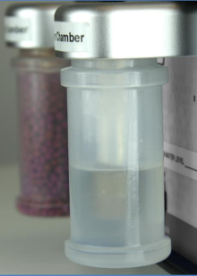
F-900 PolarCept
To utilize PolarCept, place distilled (DI) water in ‘Chamber In’ on the back of the unit
DO NOT fill beyond max fill line!
Gas from the sample environment is passed through the water trap
Some of the polar molecules are held in the trap, while ethylene passes through the water trap to the sensor
The water being used can become saturated after several minutes, so it must be cleaned of the trapped interfering gas molecules.
Trapped gases are driven out of the water during the cleaning time by a concentration gradient

Slide 7
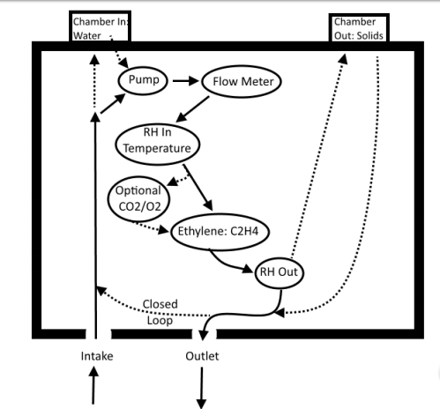
F-900 Flow path
The F-900 flow rate is regulated by a pump and flow meter
Additional optional sensors are enabled/disabled in the Setup menu as well as “conditioning chambers” on the back of the instrument
Chamber In: usually used with DI water for PolarCept
Chamber Out: usually used with various consumables to condition air returning to a closed container or to set zero for the ethylene sensors
Potassium permanganate (KMnO4)
Soda lime
Silica gel

Slide 8
F-900 Current specs
 | Measurement range | Accuracy (absolute) | Accuracy (relative) | Lower detection limit | Operating temperature | Operating RH | Zero interval | Calibration interval
ppb sensor | 0-10ppm (10000ppb) | 0.030ppm | 5% | 0.030ppm | 0-50 C | 15-95% | Weekly | 3mo
ppm sensor | 0-200ppm | 0.2ppm | 5% | 0.2ppm | 0-50 C | 15-95% | Weekly | 3mo

Slide 9
F-900 Optional sensors
 | Measurement range | Accuracy (relative) | Zero interval | Calibration interval
CO2 ppm (IRGA) | 1-2000ppm | 3% | Weekly | 12mo
CO2 percent (IRGA) | 0-100% | 3% | Weekly | 12mo
02 percent (electrochemical) | 0-100% | 2% | Weekly | 6mo

Slide 10
F-900 Front panel
Navigation and selection buttons
Micro USB port, used to charge the instrument or connect it to your PC
F-900 display screen; currently displaying main menu
Intake of sample gas into the instrument
SD card slot, measurements are saved to the SD card
Outtake of the sample gas

Slide 11
F-900 Back panel
Serial number of the instrument
Chamber Out typically holds various solids
KMnO4 to set zero or scrub ethylene
Silica gel to scrub humidity
Soda lime to scrub CO2
Chamber In typically holds DI water for Polarcept
Terminal block

Slide 12
F-900 Menu systems: Measure
The main menu of the F-900 displays four choices: Measure, Setup, View, and File
The Measure, Setup, and File menus will be addressed in this PowerPoint, please see the manual for more details on each menu
The diagram below illustrates the options obtained under the Measure menu
Measure
Sensor stability
Graph View
Monitor View
Settings

Slide 13
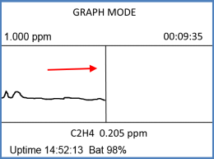
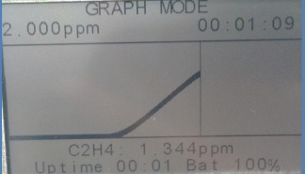
Measure: Graph view
Once you select measurement, graph view will be entered automatically when the unit has stabilized in the Sensor Stability screen.
This view graphically displays the measured C2H4 values over time
The y-axis scale can be adjusted using the up and down arrow keys but will also self adjust with the ethylene concentrations being measured

Slide 14
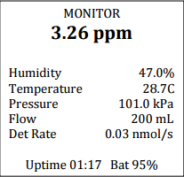
Measure: Monitor view
Pressing the right arrow from the graph view will take you to the monitor view
The large bold value on the top line is the digitally filtered value of raw ethylene measurements
Other data displayed includes: relative humidity, temperature, atmospheric pressure, flow rate, and if the sensors are present-values for CO2 and O2

Slide 15
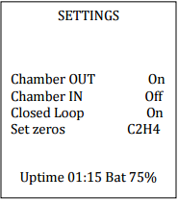
Measure: Settings
The Settings screen displays a short list of variables which may be manipulated while measurements are being made
Exterior conditioning chambers can be turned on/off
Closed loop or open loop can be selected
Closed loop will close valves causing the gas to circulate internally
Ethylene zero calibration can be performed

Slide 16
F-900 Setup menu (Part 1)
Setup
Measure
Autosave
GC emulation
Monitor

Slide 17
Setup: Measure & Autosave
Under the Setup menu, measurement allows you to select between monitor mode and GC emulation mode
The only time the F-900 should not be used in monitor mode is when using the GC emulation port on the front of the instrument
Setup Autosave can be turned on or off
Program is defaulted to on, a measurement is saved to the SD card in monitor mode at a specified interval
If turned off, the save key must be pressed during measurement to record the measurement to the SD card

Slide 18
F-900 Setup menu (Part 2)
Setup
Sensor
Sensor selection
Sensor
Cell hydration

Slide 19
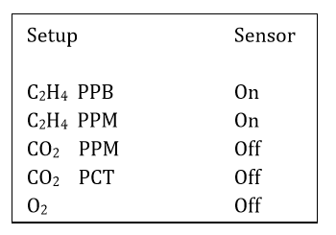
Setup: Sensor
The Setup Sensor menu has options to turn on/off the different sensors on the F-900
Both ethylene sensors should always be turned on for measurements
If sensors are not included in your instrument, set them to off
If not actively using the CO2 ppm sensor, set it to off to conserve battery life

Slide 20
F-900 Setup menu (Part 3)
Setup
Calibration
C2H4
CO2
O2
System DAC
Flow
C2H4 ppb
C2H4 ppm
Offset autocorrection
Sensitivity correction
Calibration parameters
Recalibration
Calibration parameters
Recalibration

Slide 21
F-900 Calibration
With the new F-900 hardware release, all sensors can be calibrated directly on the device verses using the controller software
Navigate to Setup>Calibration and select the desired sensor to calibrate
Always perform a set zero before calibration
Span calibrations require the use of standardized gases

Slide 22
F-900 Setup menu (Part 4)
Setup
Time
Flow
Chamber
Terminals
Board

Slide 23
Setup: Flow
The default flow rate of the F-900 is ~80 ml/min, but can be adjusted to suite your needs (do not exceed 200 ml/min)
If measuring bottled gas, a lower flow rate may be used
If measuring open air, a higher flow rate is acceptable

Slide 24
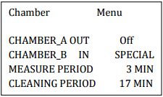
Setup: Chamber
The Setup Chamber selection allows you turn on/off the conditioning chambers on the back of the instrument
Chamber In has three options in the menu
Chamber In set to off
Chamber In set to on
Chamber In set to Special
Typically used for PolarCept in conjunction with longer term studies on ethylene accumulation or ethylene production rate
Chamber Out must have KMnO4 in it, which is used to regenerate the DI water
When this is selected you will also see a measure and cleaning time appear
A small measurement to cleaning time ratio is recommended

Slide 25
Setup: Chamber In Special
Typical graph view output for Chamber In in “special” mode
The measure peaks are your ethylene measurements, while the cleaning troughs indicate when PolarCept is being regenerated by the KMnO4 in Chamber Out

Slide 26
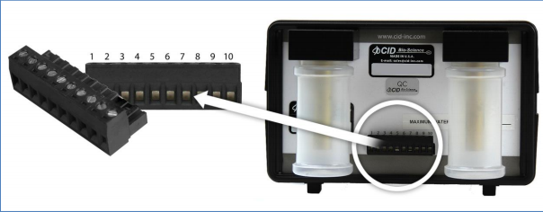
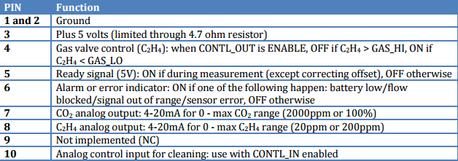
Setup: Terminal
Under Setup Terminal users can develop protocols that change the environment of the experiment or conditioning room if an upper or lower concentration of the gas of interest is reached
Increases the versatility of the instrument
Allows the F-900 to become both a sensor and controller

Slide 27
F-900 File menu
File
Clear
Delete
Create
Open

Slide 28
File menu
The F-900 uses an SD card to store all measurements
Users are able to clear, delete, create, and open files on the SD card from the File menu display
Clearing a file deletes the measurements saved in the file, but not the file itself
Deleting a file deletes the measurements and the file
Create a new file
File must end in a number
Avoid special characters
Open a file to store measurements to it
If no file is opened, measurements are saved to file001

Slide 29
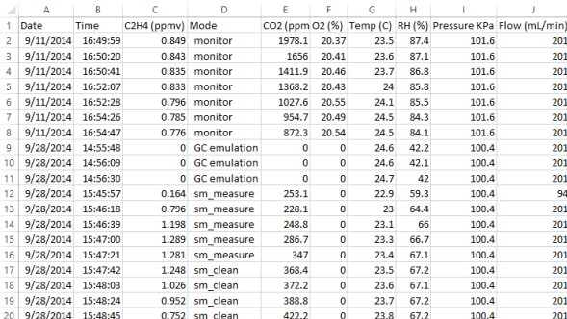
F-900 Data transfer
When a sensor is disabled, the resulting data file will show zeros
Measurements are saved as .csv files to the SD card
It is important to copy the data to your PC before starting to manipulate and analyze
When opened in excel, data columns include date and time of measurement, ethylene level in ppm, the mode of measurement, CO2 and O2 concentration (if enabled), temperature and RH of the gas stream, and flow of the gas stream
Monitor indicates measurements without PolarCept
Sm_measure or sm_clean indicate Chamber In in Special mode
Offset indicates zero calibration

Slide 30
F-900 Support
Do you have any questions about the instrument? Please contact our support team any time at support@felixinstruments.com to speak with a technical support scientist we’re always happy to help!
Follow us on Facebook, Twitter, and Instagram to stay up to date on the latest at Felix Instruments!

