Slide 1
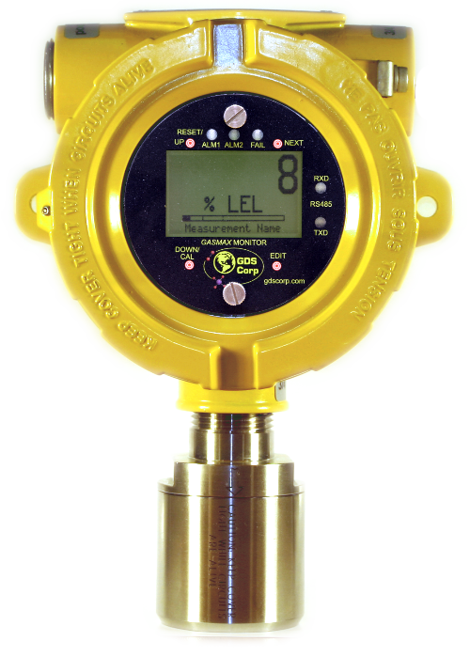

GDS Corp
Gas Detection Products
For Personnel Protection & Process Monitoring

Slide 2
Today’s Agenda
Gas Detection System Requirements
Gas and Flame Monitors & Sensors
Display & Alarm Controllers
Process Monitors
Custom Applications
Notes:
This training segment will prepare a sales guy to make his initial sales call to a customer.
The slide presentation will be made available to you either on the website or email.
You can modify the presentation to present to your customer.

Slide 3
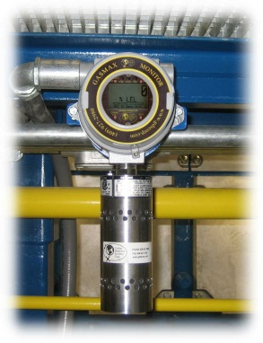
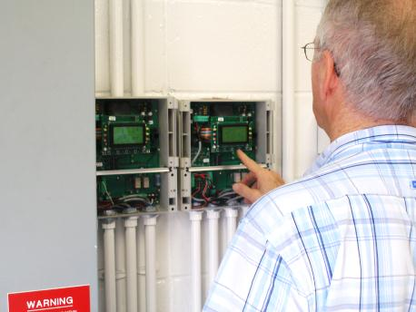
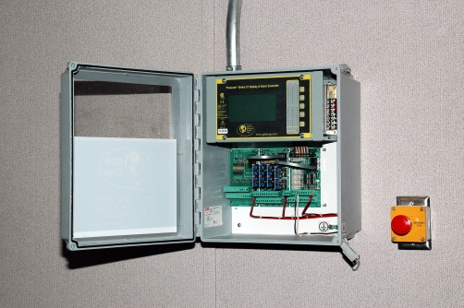
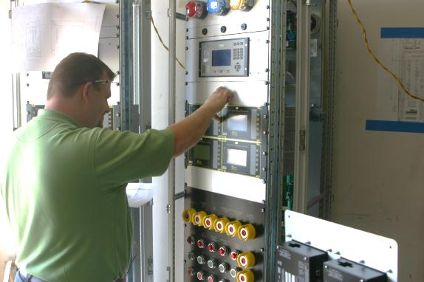
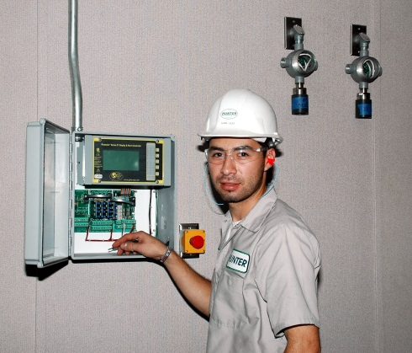
Gas Detection System “Must-Have”
Critical Reliability, Plus Best Technology for the Intended Application
Fast Delivery to Meet Real-time Customer Needs
Easy to Use, Easy to Maintain, Easy to Upgrade
Complete Solutions, not Just “Parts”

Slide 4
Design & Installation Considerations
Why am I taking these measurements? Risk of explosion? Presence of toxic gases?
What are my target gases and related concentrations? Are there gases that interfere or mask the target gas?
What environmental conditions exist that might impact the operation of gas detection equipment? Temperature? Moisture?
How will I deal with maintenance and periodic calibration?

Slide 5


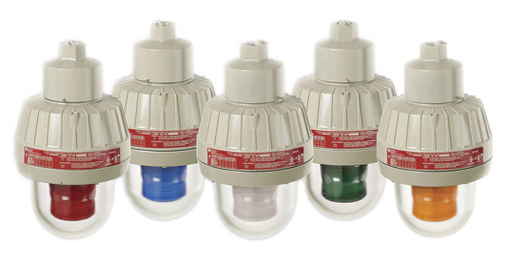
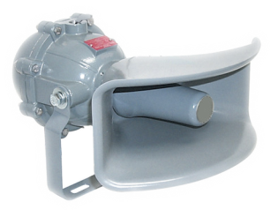
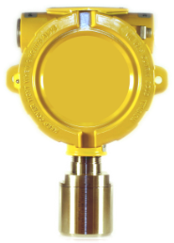
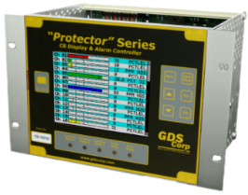
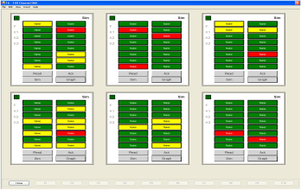
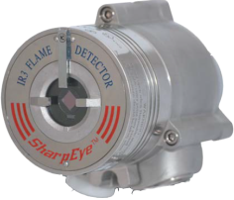
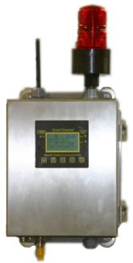
Essentials of a Gas & Flame Detection System
Gas Detectors
Gas Sensors
Flame Detectors
Display & Alarm Controllers
Solar or UPS Power Supplies
Remote Indication & Display
Notes:
There is allot of material to cover. This session will be a full 1 to 1.5 hours.

Slide 6
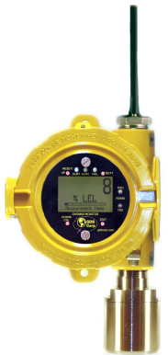
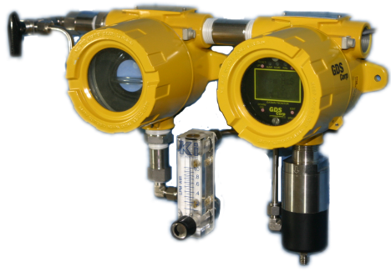
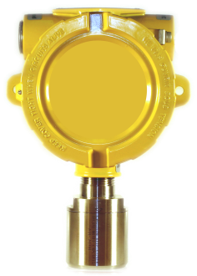
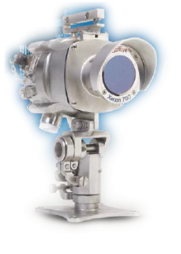
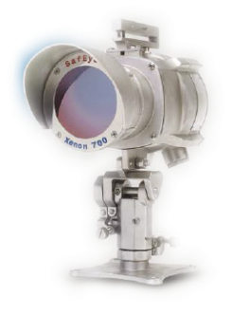
Gas Monitors & Gas Sensors
“Gas Monitors” are fully integrated gas detectors that include local or remote sensors, local display and one-person calibration; wired and wireless output
“Sample Draw” systems use pumps or vacuum to pull gas from locations unsuitable for ambient sensors
“Gas Sensors” output gas values in mA or ‘direct bridge’ millivolts and require calibration at the controller
“Flame Detectors” monitor infrared, visible and UV spectra for flame signatures
“Open Path” gas detectors sense the presence of hydrocarbon gas clouds between source and receiver

Slide 7

GASMAX II
DC-Powered Single / Dual Channel Gas Monitor for All Gases
Two channels: one toxic gas sensor and one direct bridge combustible sensor (or 4-20mA)
Graphic LCD shows value and 30 min trend; LEDs provide visual alarm
Non-intrusive “One Person” calibration using magnetic wand
Local Smart Sensors retain calibration constants
Estimates sensor life reading after each calibration
Dual 4-20mA output standard
Options include 5A alarm relays, Modbus® interface, isolated 4-20mA outputs
C
US
Notes:
Is the GASMAX/EC loop powered? Yes
What kind of sensors can be used with the GASMAX/EC? EC = electrochemical
The Gasmax II has additional features that are not available on the Gasmax/EC
Two channel GASMAX II.

Slide 8
GASMAX / EC
Loop-Powered Gas Monitor for Toxic Gases
Accepts any GDS Corp toxic gas sensor
Graphic LCD value & trend line
Flashing LED visual alarm indication
Non-intrusive “One Person” calibration using magnetic wand
Local Smart Sensors retain calibration constants & setup data
Supports any GDS Corp EC sensor
Calculates estimated “sensor life” after each calibration
Non-polarized loop output
Available for XP or IS installations
C
US
Notes:
Our flag ship product is the GASMAX/EC and GASMAX II.
We have added an important feature to both. This feature allows customers to manage assets [sensors] by determining the when to replace the sensors.
What does “One Man” calibration mean?
We will get into the calibration of GASMAX during the next training session.

Slide 9
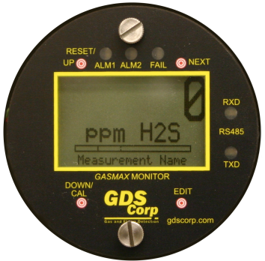
GASMAX / EC
Loop-Powered Gas Monitor for Toxic Gases
Oxygen (O2)
Carbon Monoxide (CO)
Chlorine (CL2)
Chlorine Dioxide (CLO2)
Hydrogen (H2)
Hydrogen Sulfide (H2S)
Hydrogen Cyanide (HCN)
Hydrogen Chloride (HCL)
Hydrogen Fluoride (HF)
Sulfur Dioxide (SO2)
Ammonia (NH3)
Ozone (O3)
Ethylene Oxide (C2H4O)
Silane (SiH4)
Fluorine (F2)
Phosgene (COCL2)
Hydrazine (N2H4)
Nitric Oxide (NO)
Nitrogen Dioxide (NO2)
Mercaptan (TBM)
Tetrahydrothiophene (THT)
Diborane (B2H6)
C
US
Notes:
Our flag ship product is the GASMAX/EC and GASMAX II.
We have added an important feature to both. This feature allows customers to manage assets [sensors] by determining the when to replace the sensors.
What does “One Man” calibration mean?
We will get into the calibration of GASMAX during the next training session.

Slide 10
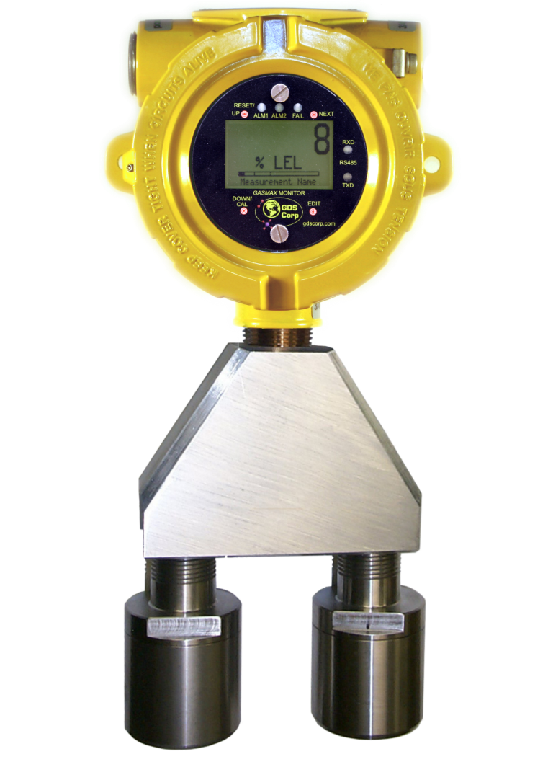
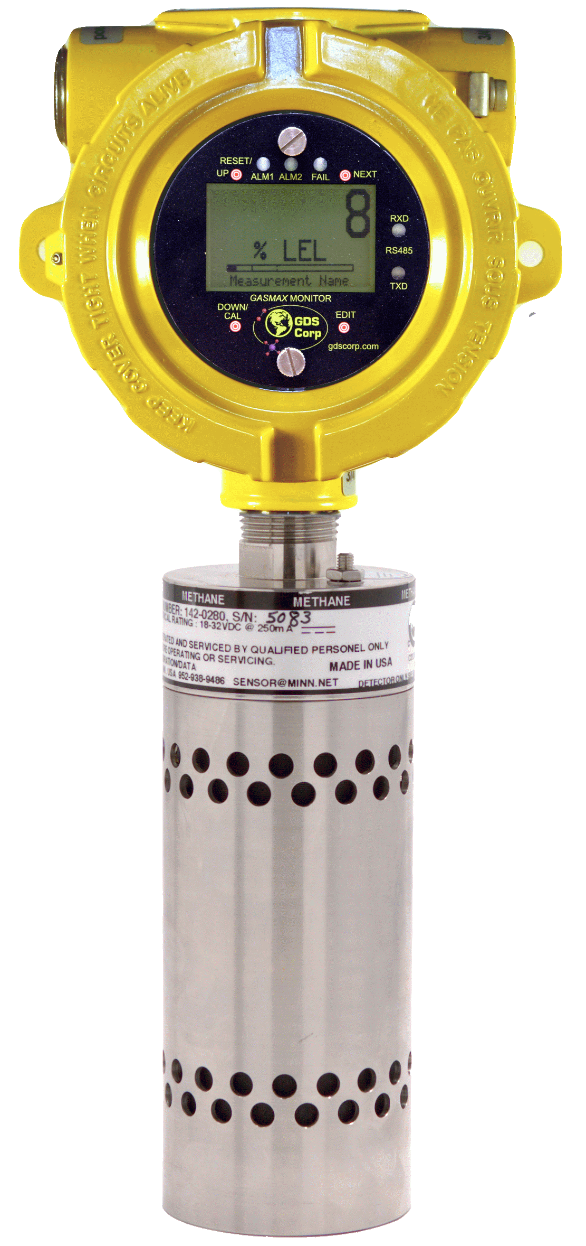
GASMAX II
DC-Powered Single / Dual Channel Gas Monitor for All Gases
All toxic gases shown for GASMAX / EC plus:
Methane (CH4)
Propane
Butane
Pentane
Ethane
Hexane
Propene
Ethylene
Ethanol
Gasoline
Diesel
Acetone
MEK
Styrene
Methane (volume)
Propane (volume)
General hydrocarbons
Benzene
Toluene
Xylene
General VOCs
Carbon Dioxide ppm
Carbon Dioxide (volume)
Others
GASMAX II plus GDS-IR Infrared Sensor
C
US
Notes:
Is the GASMAX/EC loop powered? Yes
What kind of sensors can be used with the GASMAX/EC? EC = electrochemical
The Gasmax II has additional features that are not available on the Gasmax/EC
Two channel GASMAX II.

Slide 11
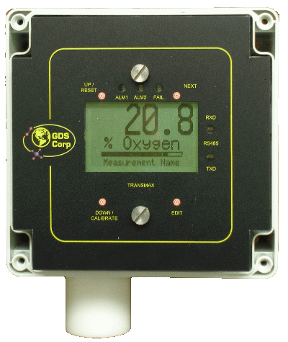
TRANSMAX / EC & II
GDS Corp Gas Monitor for General Purpose Areas
Loop-powered and DC-powered gas monitors for general purpose areas
Same electronics and features as GASMAX monitors, but in NEMA 4X non-metallic enclosure
Lightweight Delrin® sensor head with disposable sensor (stainless head also available)
Analog, MODBUS and relay output
Notes:
Our flag ship product is the GASMAX/EC and GASMAX II.
We have added an important feature to both. This feature allows customers to manage assets [sensors] by determining the when to replace the sensors.
What does “One Man” calibration mean?
We will get into the calibration of GASMAX during the next training session.

Slide 12
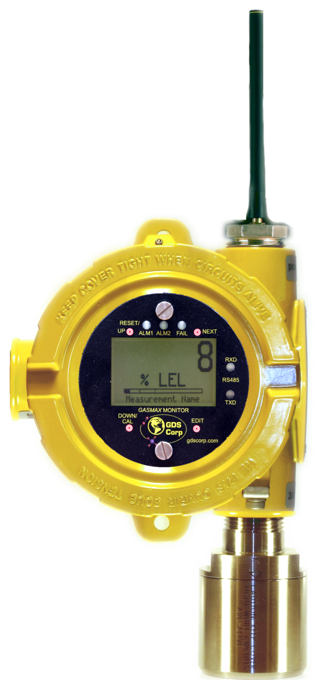
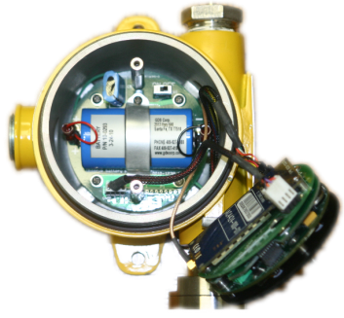
GASMAX / ECx
Battery-Powered Wireless Gas Monitor for Toxic Gases
Battery-powered Infrared Combustible in 2H ‘13
License-free 900Mhz or 2.4Ghz Wireless Modem transmits data when gas is present*
Internal Lithium battery provides an estimated 6 months of operation under normal conditions (no alarms)
Full graphical interface with 30 min trend display, event log and more
Supports any GDS Corp EC sensor
Non-intrusive “One Person” calibration using magnetic wand
Interface to C1, C64 or C2 Quad Protector Controller with wireless modem
* Sensor operates continuously; microprocessor reads sensor on 6 second intervals and transmits data if alarm condition exists; transmits ‘keep alive’ signal on 5 minute intervals

Slide 13
GASMAX IIx
DC-Powered Wireless Gas Monitor for All Gases
License-free 900Mhz or 2.4Ghz Wireless Modem transmits data when gas is present*
Supports any GDS Corp toxic, bridge or 4-20mA output sensor (single channel only)
Full graphical interface with 30 min trend display, event log and more
Non-intrusive “One Person” calibration using magnetic wand
Interface to C1, C64 or C2 Quad Protector Controller with wireless modem
* Sensor operates continuously; microprocessor reads sensor on 6 second intervals and transmits data if alarm condition exists; transmits ‘keep alive’ signal on 5 minute intervals

Slide 14
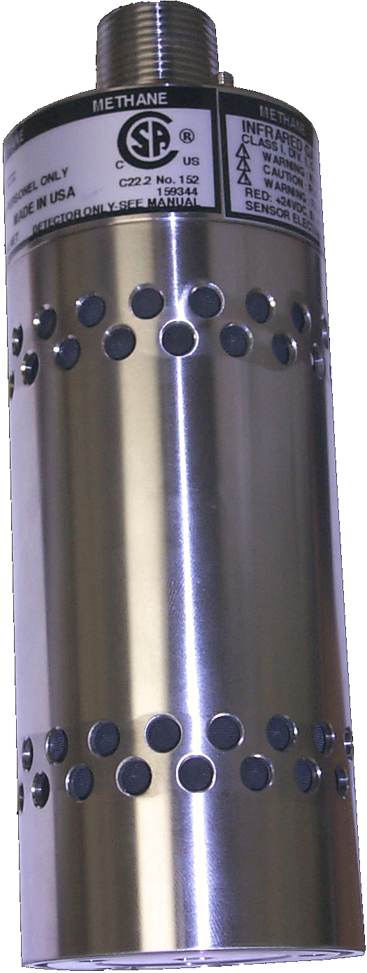
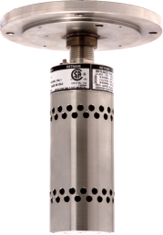
GDS-IR Infrared Sensor
Stand-alone Infrared Combustible & CO₂ Gas Sensor
Highly reliable dual wavelength design with calibrated 4-20mA output
Five year warranty on sensor; twelve year warranty on IR source
Available with flow cell for process monitoring applications
Combine with GASMAX II for display, alarms, relays and MODBUS®
CSA C22.2 No. 152 Performance Tested
Approved for Class 1 Division 1, Groups B, C, D
Suitable for use in SIL-2 systems

Slide 15
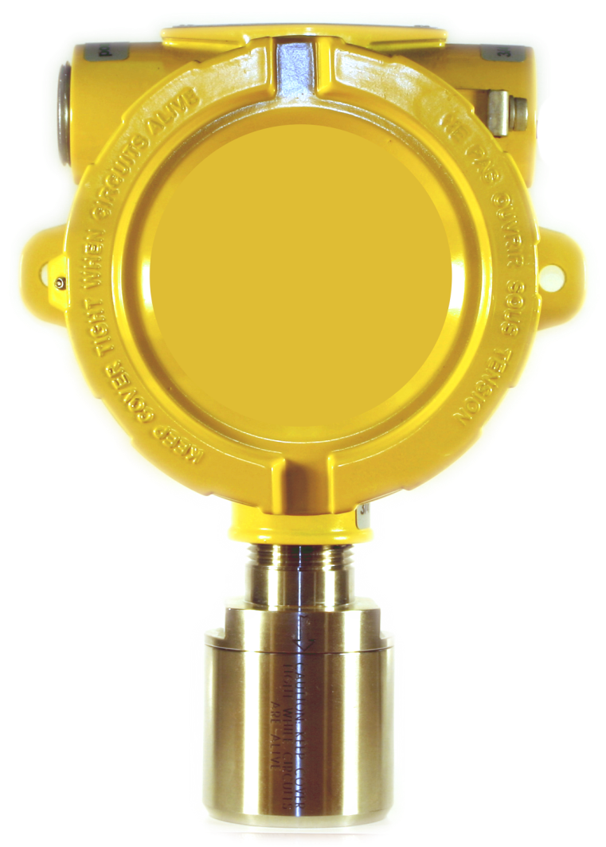
GDS-50
DC-Powered Remote Infrared Combustible & CO₂ Sensor Transmitter
Remote sensor transmitter for GDS Corp SmartIR infrared sensors
Standard 3-wire 4-20mA output
Sensors for methane, propane, hydrocarbons and carbon dioxide
Field-replaceable sensor modules
Receiving device must provide for zero and span calibration adjustment
Easy interface to all GDS Corp. alarm and display controllers

Slide 16
GDS-49
Loop-Powered Remote Toxic Sensor Transmitter
Remote sensor transmitter for all GDS Corp electrochemical sensors
Standard 2-wire 4-20mA output
CSA certified for Explosion Proof
or Intrinsically Safe installations
Field-replaceable sensor modules
Receiving device must provide for zero and span calibration adjustment
Easy interface to all GDS Corp. alarm and display controllers
C
US

Slide 17
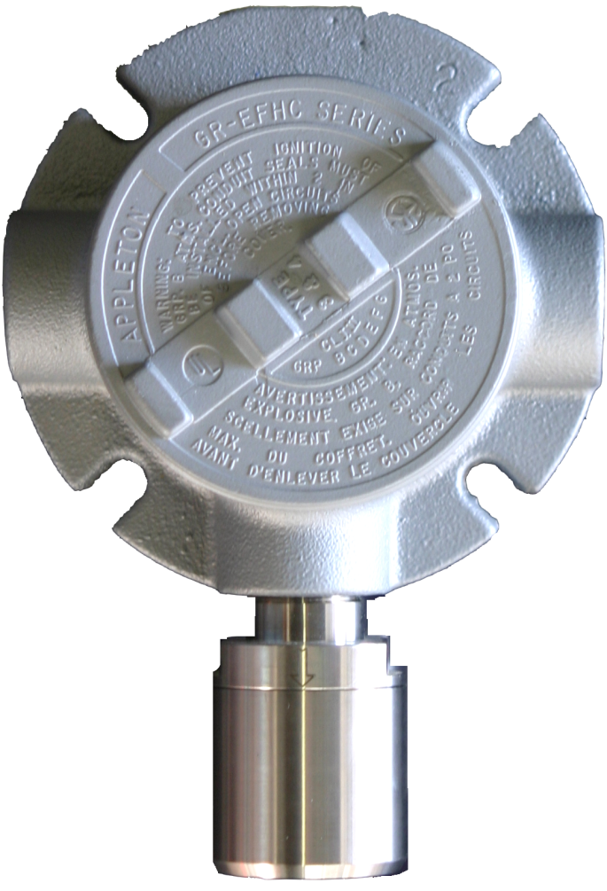
GDS-48
Direct Bridge Remote Sensor
Remote sensor for catalytic bead, photoionization and SmartIR infrared sensors
3-wire “direct bridge” output (not 4-20mA)
Sensors for all hydrocarbons, most volatile organics including benzene and toluene, and carbon dioxide
Field-replaceable sensor modules
NOTE: Receiving device must provide for zero / span calibration adjustment
Interface to all GDS Corp. alarm and display controllers configured for ‘direct bridge’ input
C
US

Slide 18
SharpEye® Flame Detectors
Self-Contained Flame Detectors for Critical Applications
SharpEye 40/40I
Triple Spectrum design for long distance detection and highest immunity to false alarms
Detects 0.1m² gasoline pan fire at 65 meters in less than 5 seconds
SharpEye 40/40L/LB
UV / IR design for long distance detection and high immunity to false alarms
Detects 0.1m² gasoline pan fire at 15 meters in less than 5 seconds
Detects hydrocarbon, hydroxyl fuels, metal and inorganic fires
Contact GDS Corp for additional flame detector options

Slide 19

GDS-58XP Sample Draw System
Self-Contained Sample Draw for Hazardous Areas
Designed to pull from wet / dirty locations where ambient sensor will not work.
Long life brushless 24VDC sample pump with built-in low flow warning switch
Adjustable flow meter visually confirms flow
GASMAX II gas monitor supports all GDS Corp toxic or combustible sensors*
Sample lines up to 100m / 300 ft in length
Dual programmable 5A alarm relays and MODBUS output standard
Prompted calibration procedure and built-in Run / Cal valve for easy maintenance
Inlet & Run / Cal
Valve
GASMAX
Monitor
DC Sample Pump
Flowmeter
Sensor & Flow Cell

Slide 20
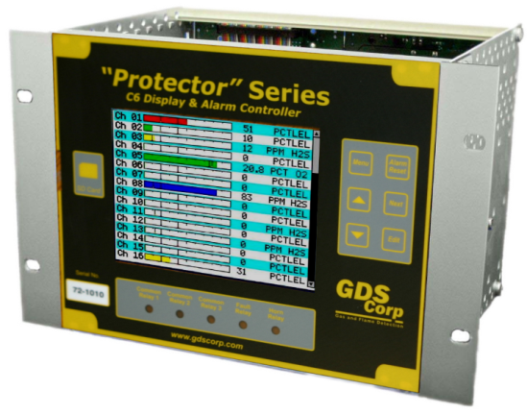
Display & Alarm Controllers
Central point of display & control for entire gas detection system
Easy access to alarm values and settings
Input signal conditioning for a wide range of sensors and devices
Calibration for low cost sensor transmitters
Programmable relay output logic for system optimization, includes Voting, Zones and
Channel / Relay Overrides*
Excitation power for remote sensors and monitors
Simplified interface to plant-wide control systems

Slide 21
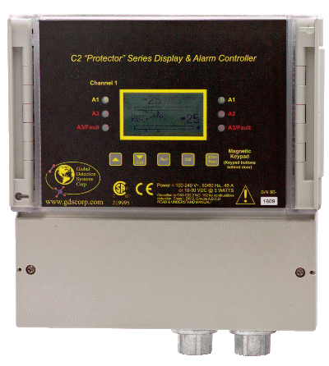
“C2 Quad Protector” Controller
Four Channel Display & Alarm Controller
Input 4 analog, 4 direct bridge, 2 analog / 2 bridge inputs or wireless
Graphic LCD displays input values, bar graph and trend data
Three independent alarm levels for each channel
Two standard common alarm relays + six optional discrete relays
Modbus® Interface slave port
117VAC or 24VDC power
Optional 50W external power supply
Class I Division 2 rated for hazardous areas
Notes:
C1 is sixteen channel: 8 and 8. All sixteen can be the same type of signal or you can divide the channels into 8 channel segments:
C2 mix and match signal inputs.

Slide 22
“C2 Protector” Controller
Two Channel Display & Alarm Controller with Local Sensors
Input two local toxic sensors, one direct bridge + one toxic, two direct bridge or two 4-20mA
Direct bridge sensors local or remote
Graphic LCD displays input values, bar graph and trend data
Three independent alarm levels for each channel
Two standard common alarm relays + six optional discrete relays
MODBUS® Interface slave port
Class I Division 2 rated for hazardous areas
Notes:
C1 is sixteen channel: 8 and 8. All sixteen can be the same type of signal or you can divide the channels into 8 channel segments:
C2 mix and match signal inputs.

Slide 23

“C1 Protector” Controller
8 or 16 Channel Controller with Analog, Bridge & MODBUS Inputs
Analog input from GASMAX, GDS-IR, GDS-49, GDS-50 or any other 4-20mA device
Direct bridge input for Catalytic bead, SmartIR, or Photoionization Detector
Wireless input for GASMAX/ECx, GASMAX/IIx
Graphics LCD plus 3x LED per channel
Four common relays plus up to 48 discrete
RS-485 MODBUS Master and Slave port
Access via Ethernet with ProtectorView
Class I Division 2 rated for hazardous areas
Notes:
C1 is sixteen channel: 8 and 8. All sixteen can be the same type of signal or you can divide the channels into 8 channel segments:
C2 mix and match signal inputs.

Slide 24

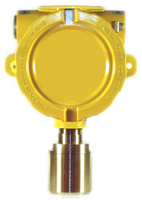

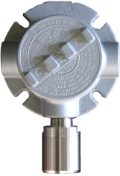
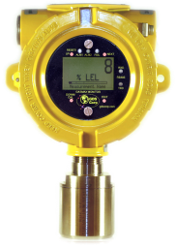
“C1 Protector” Controller
8 or 16 Channel Controller with Analog, Bridge & MODBUS Inputs
Up to 16 Sensors
Wireless
4X Programmable Alarm Relays
MODBUS RS-485 slave port
Up to six 8-channel discrete relay boards
Ethernet (with external C1D2 module)
4-20mA
Bridge
MODBUS
Input source selectable on per-channel basis
Notes:
C1 is sixteen channel: 8 and 8. All sixteen can be the same type of signal or you can divide the channels into 8 channel segments:
C2 mix and match signal inputs.

Slide 25

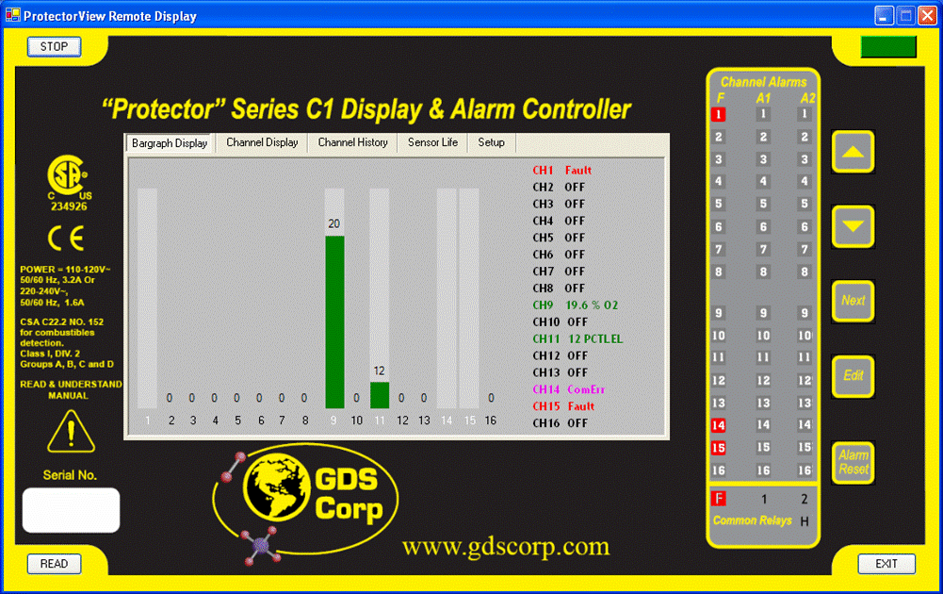

ProtectorView Software for Windows®
Remote Display for Up to Ten C1 Protector Controllers
Monitor C1 controllers across any Ethernet network
Includes Class I Div 2 MODBUS/TCP interface module for C1 controller and remote ProtectorView host software
View one controller in real time while monitoring up to 9 more for alarm conditions
View alarm status and settings in easy-to-read format
Upload and store to disk controller’s internal 24 hour trend database
Ethernet Network

Slide 26

ProtectorView Software for Windows®
Remote Display for Up to Ten C1 Protector Controllers
Color coded BARGRAPH screen shows all sixteen channels
MONITOR WARNING message if monitored C1s indicate alarm
CHANNEL DISPLAY screen shows channel trend, value min & max
CHANNEL HISTORY screen shows downloaded 24hr trend from controller
SENSOR LIFE screen shows 16x sensor life data from most recent calibrations
CONFIG screens show current alarm settings for all sixteen channels
LED status indicators mirror function on C1 in real time

Slide 27

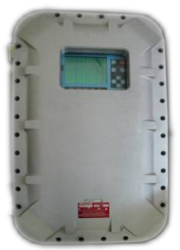
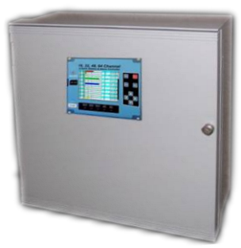
“C64 Protector” Controller
16 to 64 Channel Controller with Analog, Bridge & MODBUS Inputs
Up to 64 input channels for analog, direct bridge, MODBUS®, wireless or discrete
Full color graphic display with flashing alarms
Five common relays plus up to 256 discretes
Up to four RS-485 MODBUS serial ports
Built-in Ethernet & web page with remote setup
Programmable via voting, zones & overrides
Data logging capability built-in
Class I Division 2 rated for hazardous areas

Slide 28
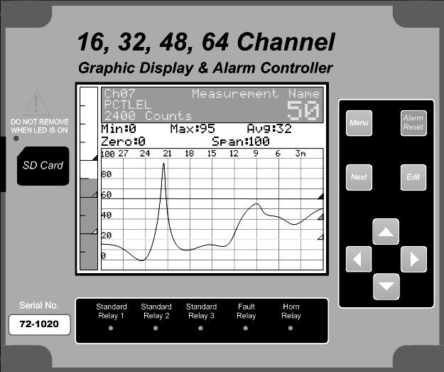
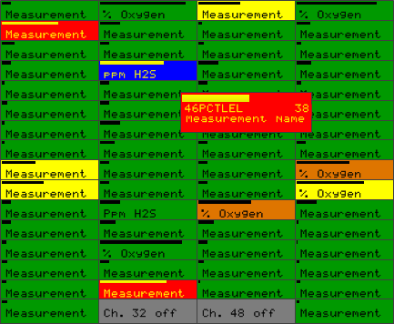
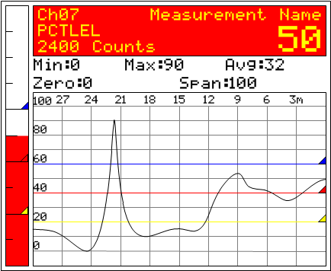
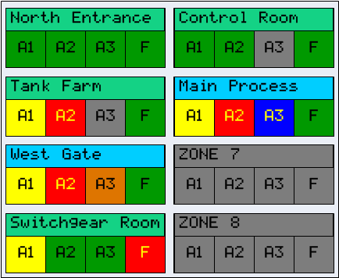
“C64 Protector” Controller
16 to 64 Channel Controller with Analog, Bridge & MODBUS Inputs
Main Data Screen shows all 64 channels status and tag names; flashing alarm indication
Bargraph Screen shows 16 channel values, alarms levels and alarm status
Combination screen shows single channel 30 minute trend, bargraph and large display
Zone screen changes color and name field flashes to indicate alarms

Slide 29
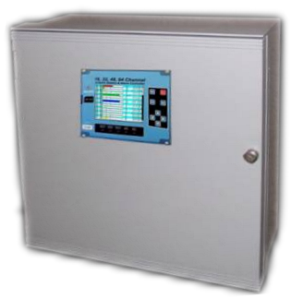
“C64 Protector” Controller
16 to 64 Channel Controller with Analog, Bridge & MODBUS Inputs
Up to 64 Sensors
5X Programmable Alarm Relays
4x MODBUS RS-485 master or slave ports
Up to sixteen 16-channel discrete relay boards (256 total)
Built-in Ethernet with Web Server and Remote Setup
Wireless
4-20mA
Bridge
MODBUS
Input source selectable on per-channel basis
Notes:
C1 is sixteen channel: 8 and 8. All sixteen can be the same type of signal or you can divide the channels into 8 channel segments:
C2 mix and match signal inputs.

Slide 30
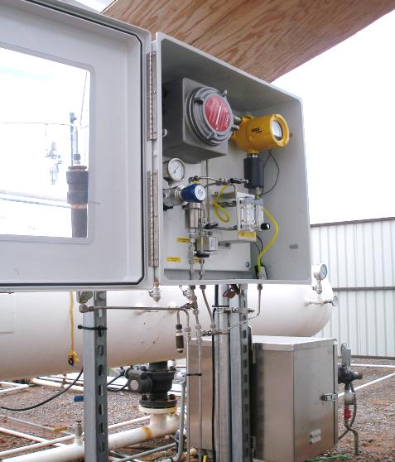
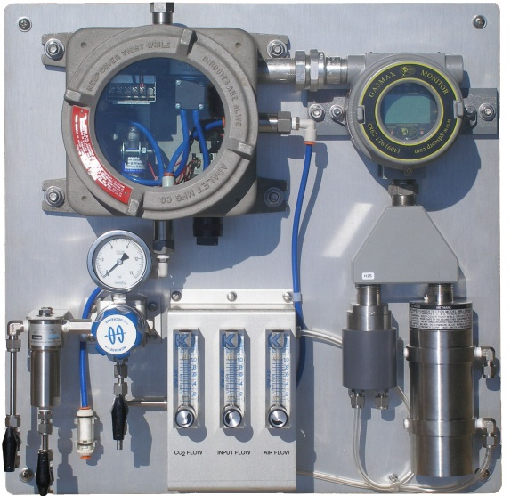
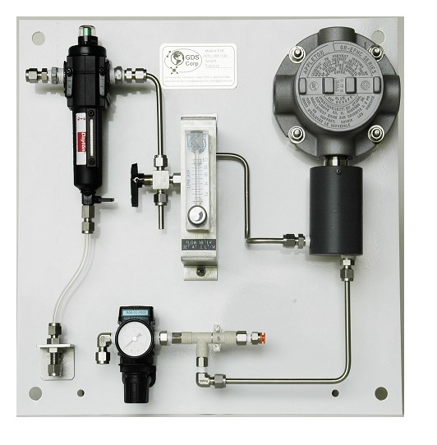
Process Monitors
Cost-effective solution where analyzer-level accuracy is not required
Combine high quality sample conditioning / filtering with reliable GASMAX gas monitor and Protector controller technology.
Semi-custom design allows build-to-requirements efficiency
GDS Corp experience in process monitors

Slide 31
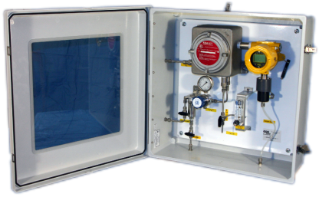
GDS-68XP Process Monitor
For Low Oxygen Process Streams
Monitors Hydrogen Sulfide, Mercaptan or THT in 100% methane or methane + carbon dioxide streams
Reliable, low cost toxic sensors and microprocessor-controlled sequencer for low total cost of ownership.
Periodic sampling at intervals from 5 minutes to six hours increases sensor life and reduces amount of target gas released to the atmosphere
Automatic over-range detection protects sensor from saturation
High quality 24VDC brushless pump
Suitable for use in Class I Division 1 areas
Available with ambient sample draw or high pressure inlet with stainless steel filter and regulator
Ideal for use on natural gas pipelines or biogas digesters

Slide 32
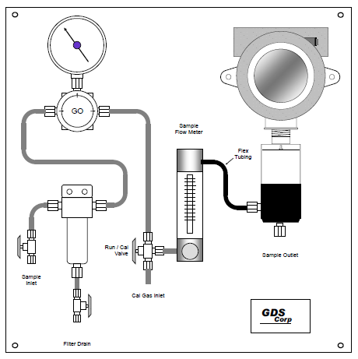
GDS-78XP Process Monitor
For High Pressure Process Streams
Semi-custom solution for monitoring a process gas stream compatible with the target toxic or infrared sensor
High quality sample conditioning with stainless steel coalescing filter or optional combination coalescing + membrane filter for maximum moisture & particulate removal.
Choice of two-wire, three-wire or wireless GASMAX gas monitor
Choice of Toxic*, PID or GDS-IR Infrared sensors, or GDS-IR-PM process analyzer sensor
Optional low flow warning switch
Designed for use in Class I Division 1 areas
* Stream must contain at least 25% oxygen for toxic sensor applications

Slide 33
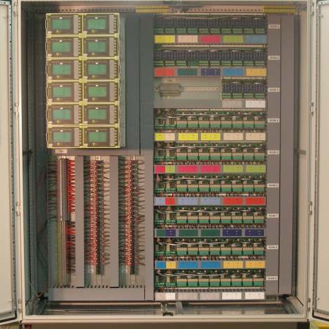
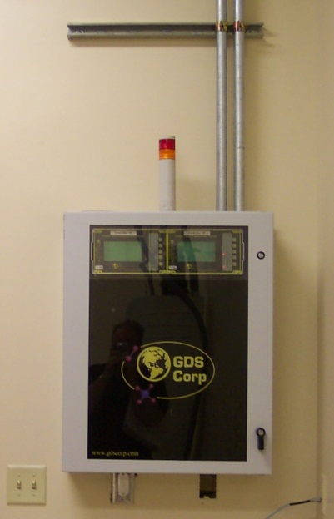
GDS Corp Custom Systems
Design / Build Systems for Petrochemical & Offshore
Design-to-order based on specific customer needs
Unique, one-of-a-kind applications
Contact GDS Corp for more details or a quote
160 point direct catalytic bead system for control of plant-wide deluge system
32 point mixed catalytic bead / infrared system to monitor combustibles and carbon monoxide levels at national research laboratory

Slide 34


Reliable technology
  Industry-recognized certifications
  Features that customers need today
  Technology for tomorrow’s systems
Fast delivery
  Products designed for rapid build-to-order
  Locally managed inventory
  Software tools simplify ordering
Easy to use
  Graphical interface
  Smart sensors
  Prompted Calibration
Complete solutions
  Monitors, sensors, controllers, power supplies, software & more

Slide 35
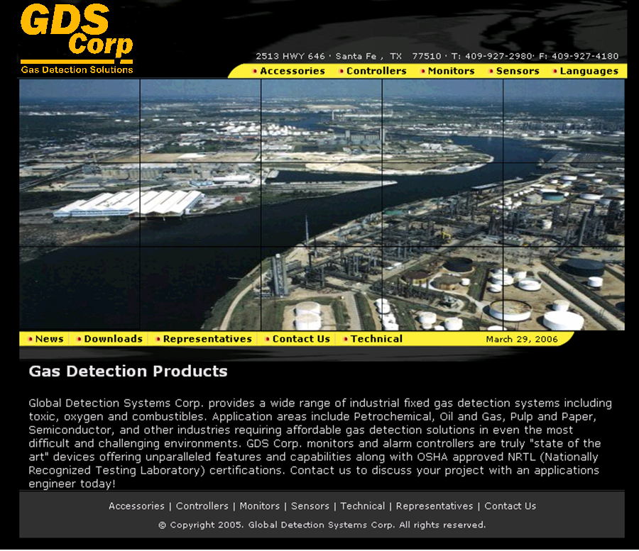
For More Information:
www.gdscorp.com

Slide 36
Thank You!

Slide 37
GDS Corp Sensor Technologies

Slide 38
Gas Sensor Technologies
Toxic
Infrared
Diffusion Barrier
Sensing Electrode
Infrared Detector
Electrolyte
Storage
Infrared Light Source
Target Gas Reacts with Electrolyte, Generates Current
Target Gas Absorbs IR Energy
Catalytic Bead
Photoionization (PID)
Active Bead
+
Current Detector
Reference Bead
Ultraviolet Light Source
Target Gas Generates Heat, Causing Imbalance
UV Ionizes Target Gas, Creating Current

Slide 39
Gas Sensor Technologies
Toxic
Infrared
Diffusion Barrier
Sensing Electrode
Infrared Detector
Electrolyte
Storage
Infrared Light Source
Target Gas Reacts with Electrolyte, Generates Current
Target Gas Absorbs IR Energy
Catalytic Bead
Photoionization (PID)
Active Bead
+
Current Detector
Reference Bead
Ultraviolet Light Source
Target Gas Generates Heat, Causing Imbalance
UV Ionizes Target Gas, Creating Current

Slide 40
Gas Sensor Technologies
Toxic
Infrared
Diffusion Barrier
Sensing Electrode
Infrared Detector
Electrolyte
Storage
Infrared Light Source
Target Gas Reacts with Electrolyte, Generates Current
Target Gas Absorbs IR Energy
Catalytic Bead
Photoionization (PID)
Lowest cost / periodic replacement required
Oxygen MUST BE PRESENT to detect combustibles
Bridge output signal
Examples: Methane, Hydrogen, Combustibles
+
Current Detector
Ultraviolet Light Source
UV Ionizes Target Gas, Creating Current

Slide 41
Gas Sensor Technologies
Toxic
Infrared
Diffusion Barrier
Sensing Electrode
Infrared Detector
Electrolyte
Storage
Infrared Light Source
Target Gas Reacts with Electrolyte, Generates Current
Target Gas Absorbs IR Energy
Catalytic Bead
Photoionization (PID)
Lowest cost / periodic replacement required
Oxygen MUST BE PRESENT to detect combustibles
Bridge output signal
Examples: Methane, Hydrogen, Combustibles
+
Current Detector
Ultraviolet Light Source
UV Ionizes Target Gas, Creating Current

Slide 42

Gas Sensor Technologies
Toxic
Infrared
Diffusion Barrier
Longer sensor life
Does not require Oxygen to detect combustibles
Bridge output signal (except GDS-IR)
Examples: Combustibles, CO₂
Sensing Electrode
Electrolyte
Storage
Target Gas Reacts with Electrolyte, Generates Current
Catalytic Bead
Photoionization (PID)
Lowest cost / periodic replacement required
Oxygen MUST BE PRESENT to detect combustibles
Bridge output signal
Examples: Methane, Hydrogen, Combustibles
+
Current Detector
Ultraviolet Light Source
UV Ionizes Target Gas, Creating Current

Slide 43

Gas Sensor Technologies
Toxic
Infrared
Diffusion Barrier
Longer sensor life
Does not require Oxygen to detect combustibles
Bridge output signal (except GDS-IR)
Examples: Combustibles, CO₂
Sensing Electrode
Electrolyte
Storage
Target Gas Reacts with Electrolyte, Generates Current
Catalytic Bead
Photoionization (PID)
Lowest cost / periodic replacement required
Oxygen MUST BE PRESENT to detect combustibles
Bridge output signal
Examples: Methane, Hydrogen, Combustibles
+
Current Detector
Ultraviolet Light Source
UV Ionizes Target Gas, Creating Current

Slide 44

Gas Sensor Technologies
Toxic
Infrared
Wide range of specific target gases
Sensor life determined by environmental factors (%RH, ambient gases / poisons)
Requires Oxygen to function
Micro-amp output signal
Examples: H₂S, O₂, CO
Longer sensor life
Does not require Oxygen to detect combustibles
Bridge output signal (except GDS-IR)
Examples: Combustibles, CO₂
Catalytic Bead
Photoionization (PID)
Lowest cost / periodic replacement required
Oxygen MUST BE PRESENT to detect combustibles
Bridge output signal
Examples: Methane, Hydrogen, Combustibles
+
Current Detector
Ultraviolet Light Source
UV Ionizes Target Gas, Creating Current

Slide 45
Gas Sensor Technologies
Toxic
Infrared
Wide range of specific target gases
Sensor life determined by environmental factors (%RH, ambient gases / poisons)
Requires Oxygen to function
Micro-amp output signal
Examples: H₂S, O₂, CO
Longer sensor life
Does not require Oxygen to detect combustibles
Bridge output signal (except GDS-IR)
Examples: Combustibles, CO₂
Catalytic Bead
Photoionization (PID)
Lowest cost / periodic replacement required
Oxygen MUST BE PRESENT to detect combustibles
Bridge output signal
Examples: Methane, Hydrogen, Combustibles
e⁻
+
Current Detector
e⁻
Ultraviolet Light Source
UV Ionizes Target Gas, Creating Current

Slide 46

Gas Sensor Technologies
Toxic
Infrared
Wide range of specific target gases
Sensor life determined by environmental factors (%RH, ambient gases / poisons)
Requires Oxygen to function
Micro-amp output signal
Examples: H₂S, O₂, CO
Longer sensor life
Does not require Oxygen to detect combustibles
Bridge output signal (except GDS-IR)
Examples: Combustibles, CO₂
Catalytic Bead
Photoionization (PID)
Lowest cost / periodic replacement required
Oxygen MUST BE PRESENT to detect combustibles
Bridge output signal
Examples: Methane, Hydrogen, Combustibles
Wide range of detectable gases (determined by energy of UV lamp)
Not specific to particular VOC component
Bridge output signal
Examples: Benzene, Gasoline, Volatile Organic Compounds (VOC)

Slide 47
Toxic & Combustible Gas Detection

Slide 48
Combustible Gas Detection
Combustible gas is measured on the basis of “Percent (of) Lower Explosive Limit, or %LEL of a specific target gas
LEL values for most gases are well known and alarm values can be readily calculated for maximum safety
Generally, alarm values are set for 20% LEL (high alarm) and 40% LEL (high-high alarm), but may vary based on gas and risk
Most combustible gas sensors are not specific and will respond to any combustible gas
Infrared sensors will not detect hydrogen

Slide 49
Combustible Gas Detection
100% by Volume
UEL
“Upper Explosive Limit”
“Lower Explosive Limit”
LEL
0% by Volume

Slide 50
Combustible Gas Detection
100% by Volume
UEL
“Upper Explosive Limit”
“Lower Explosive Limit”
LEL
Insufficient gas to support combustion
0% by Volume

Slide 51
Combustible Gas Detection
100% by Volume
Insufficient oxygen to support combustion
UEL
“Upper Explosive Limit”
“Lower Explosive Limit”
LEL
Insufficient gas to support combustion
0% by Volume

Slide 52

Combustible Gas Detection
100% by Volume
Insufficient oxygen to support combustion
UEL
“Upper Explosive Limit”
Any mixture in this range WILL support combustion
“Lower Explosive Limit”
LEL
Insufficient gas to support combustion
0% by Volume

Slide 53
Combustible Gas Detection
Combustible gases have different values for LEL and UEL
UEL
Gasoline UEL = 7.1%
Gasoline LEL = 1.2%
LEL

Slide 54
Combustible Gas Detection
Ethylene Oxide UEL = 100%
Combustible gases have different values for LEL and UEL
An unknown mixture of combustible gases may have a unique LEL
Ethylene Oxide LEL = 3.6%
LEL

Slide 55
Combustible Gas Detection
Combustible gases have different values for LEL and UEL
An unknown mixture of combustible gases may have a unique LEL
UEL
Methane UEL = 15%
Methane LEL = 5%
Methane (CH₄) is often used as a reference for calibration purposes
LEL
0 – 100% LEL

Slide 56
Toxic Gas Detection
Toxic limits are based on tests and recommendations from OSHA* and NISOH*
IDLH (Immediately Dangerous to Life or Health) specifications based on human & animal toxicity, 10% of LEL, effects of similar known chemicals and historic norms
Exposure is measured in instantaneous and average values; Averages must be calculated from GDS Corp equipment readings
NIOSH: US National Institute for Occupational Safety and Health
OSHA: US Occupational Safety and Health Administration

Slide 57
Toxic Gas Exposure Limits
Ceiling Exposure Limit - CEV
(Maximum exposure at any time)

Slide 58
Toxic Gas Exposure Limits
Ceiling Exposure Limit - CEV
(Maximum exposure at any time)
Short Term Exposure Limit - STEL
(Average exposure over 15 minutes)

Slide 59
Toxic Gas Exposure Limits
Ceiling Exposure Limit - CEV
(Maximum exposure at any time)
Short Term Exposure Limit - STEL
(Average exposure over 15 minutes)
Time-Weighted Average - TWA
(Average exposure over 8 hours)

Slide 60
Toxic Gas Exposure Limits
CEV = 12 ppm
Ceiling Exposure Limit - CEV
(Maximum exposure at any time)
Short Term Exposure Limit - STEL
(Average exposure over 15 minutes)
Time-Weighted Average - TWA
(Average exposure over 8 hours)

Slide 61
Toxic Gas Exposure Limits
CEV = 12 ppm
Ceiling Exposure Limit - CEV
(Maximum exposure at any time)
Short Term Exposure Limit - STEL
(Average exposure over 15 minutes)
STEL = 2 ppm
Time-Weighted Average - TWA
(Average exposure over 8 hours)

Slide 62
Toxic Gas Exposure Limits
CEV = 12 ppm
Ceiling Exposure Limit - CEV
(Maximum exposure at any time)
Short Term Exposure Limit - STEL
(Average exposure over 15 minutes)
STEL = 2 ppm
Time-Weighted Average - TWA
(Average exposure over 8 hours)
TWA = 0.05 ppm

